Slide 1
STM32 – Temperature sensor
Federica Villa

Slide 2
Temperature sensor on POLIMI board
I²C interface

Slide 3
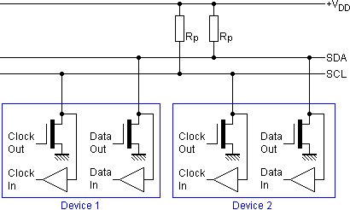
I²C protocol basics
Inter Integrated Circuit → IIC → I²C
Many devices share same bus
Multi-master, multi-slave protocol Open drain outputs (non-destructive arbitration, zero wins)
Transmission rates: 100 kbps (Standard mode), 400 kbps (Fast mode), 3.4 Mbps (High speed mode), 5 Mbps (Ultra-fast mode) Not supported by the STM32F401
Two wires connection:
SDA (for data)
SCL (clock)
(+ common ground)
Both SDA and SCL are bidirectional

Slide 4
I²C protocol: START and STOP
When there’s no trasmission, both SCL and SDA are kept «high».
START: transition from high to low of SDA, while SCL is kept high.
STOP: transition from low to high of SDA, while SCL is kept high.
SDA
SCL
SDA
SCL

Slide 5
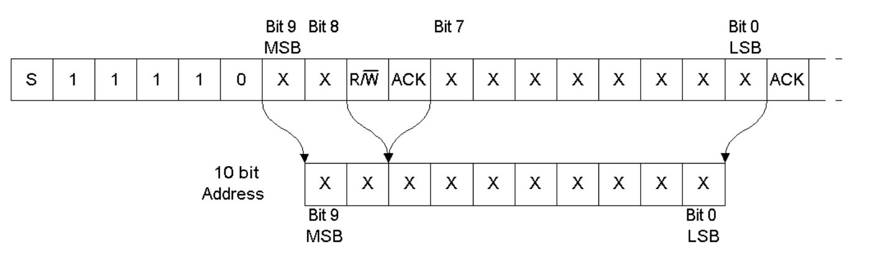
I²C protocol: addressing
Each device connected to the I2C bus has a unique address, in either of 2 formats:
7-bit format with one read/write bit.
10-bit format with one read/write bit
ACK BIT
S | 0 | 0 | 1 | 0 | 1 | 0 | 1 | R/W | ACK
START BIT
READ/WRITE BIT:
‘1’ to READ
‘0’ to WRITE
7-bit slave address
This sequence tells that we are going to transmit a 10-bit address

Slide 6
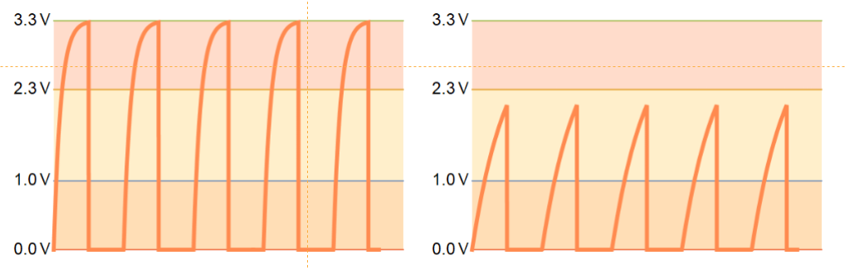
I²C protocol: data packets and speed
Data is packed in bytes, there’s no limitation on the number of bytes.
Acknowledge bit controls transmissions: if no ACK, communication stops:
In slave-receiver mode, the slave necessarily needs to acknowledge the byte; otherwise the communication stops (e.g. if the address is wrong, no ACK is raised and communication halts)
In master-receiver mode, the master deliberately doesn’t ack the last byte in order to stop the communication.
High-Low transitions are fast (driven by an NMOS with low impedance).
Low-High transitions limited by circuit RC:
pull-up resistor value typ: 1 to 10 kΩ / bus capacitance typ. 10 to 100 pF
Normal operation!
Too fast transitions!

Slide 7
I²C protocol: transmission example
Since a SDA transition during SCL high will bring to a START/STOP condition, the data transfer necessarly occurs when SCL is low.
Example of transmission:

Slide 8
ADC HAL functions
HAL functions for I²C:
HAL_StatusTypeDef HAL_I2C_Master_Transmit(I2C_HandleTypeDef *hi2c, uint16_t DevAddress,
uint8_t *pData, uint16_t Size, uint32_t Timeout)
HAL_StatusTypeDef HAL_I2C_Master_Receive(I2C_HandleTypeDef *hi2c, uint16_t DevAddress,
uint8_t *pData, uint16_t Size, uint32_t Timeout)
uint16_t DevAddress is the device address
uint8_t *pData is the data to be sent/received
uint16_t Size is the number of bytes to be sent/received

Slide 9
LM75/LM75B
Band gap temperature sensor + 9 (B: 11) bit ADC LSB =0.5 °C (B: 0.125°C), range -55°C to 125°C 8 bit integer temperature in °C (MSB sign bit) + 3 bit decimal (LM75B) + 1 bit decimal (LM75) (two’s complement digital data)
Temperature register (address 0x00) stores the converted temperature
I²C interface
LM75/LM75B address: 1001 + 000 → 1001000 (7 bit address)
Different board batches!
 | MSByte |  |  |  |  |  |  |  | LSByte
 | 7 | 6 | 5 | 4 | 3 | 2 | 1 | 0 | 7 | 6 | 5 | 4 | 3 | 2 | 1 | 0
LM75B | D10 | D9 | D8 | D7 | D6 | D5 | D4 | D3 | D2 | D1 | D0 | X | X | X | X | X
LM75 | D8 | D7 | D6 | D5 | D4 | D3 | D2 | D1 | D0 | X | X | X | X | X | X | X

Slide 10
Project 1
Read the temperature measured by the LM75 and send it to a remote terminal every 1 second.
As a first step we will read only the MSB 8 bit.

Slide 11
Project hints
In CUBE configure the I2C in standard mode and enable the USART.
Generate the c code.
In the while loop read the MSByte of the temperature register using the I2C functions. When you declare the variables, watch out for the data types needed by the I2C functions.
Send the value to the PC using the USART interface and add a proper delay to repeat the loop every 1 s.
Do you need to do any conversions in order to obtain the value of temperature in °C?

Slide 12
Project 1b
Now we will modify the code to read all 11 bits within an interrupt routine

Slide 13
Project hints
Modify the code to read both MSByte and LSByte of the temperature register.
Convert the values of MSByte and LSByte in a value of temperature with 3 decimal places. Hint: verify your conversion function with the example values reported on the datasheet in Table 10 (pp. 9-10)
Send the value to the PC using the USART interface using a timer to generate an interrupt every second.

Slide 14
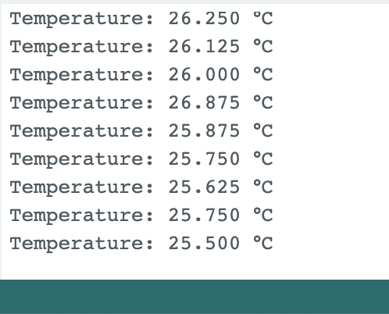
Bug to be checked
If you only read once the temperature bytes, you might observe this bug.
In this case the temperature was decreasing, but for some reasons (it is up to you to find the reason) it passes from 26 °C to 26.875 °C instead of 25.875 °C.

